Slide 1

New Gender Institute seminar series:
Women in academia
Are women in academia affected by subtle micro-inequities, which accumulate over time and eventually form powerful barriers to their career advancement?
Is the academic workplace of the 21st century a fair playing field?
Is the ANU succeeding in effectively supporting women's career progression or are there issues in need of discussion?
Notes:
1 minute: This talk presents my research on gender and science career plans of adolescents. Part of this research was undertaken as a consultancy for the OECD’s Directorate of Education in Paris in 2010.
I will be making two points
The first is that we must look at the relationship between gender and specific science fields rather than treating science as one broad homogeneous domain.
The second point is that to understand women’s participation in science we must see it as part of a broader social phenomenon, namely as part of gender segregation in education and employment. Segregation can be detrimental for women but also for men.
My research explores international patterns in science career plans of young people using the Program for International Student Assessment. Let us take 3 minutes to watch a movie clip which explains what PISA is and what PISA does
HOW EFFECTIVELY THEY EDUCATE THEIR CHILDREN

Slide 2
When? 4:00pm to 6:00pm on first Monday or Tuesday of each month in 2013, except for July:
Monday, 3 June 2013 Fiona Jenkins, ANU
Monday, 5 August 2013 Stina Powell, Sweden
Monday, 2 September 2013 Maureen Baker, New Zealand
Tuesday, 8 October 2013 Dirk Van Rooy, ANU
Monday, 5 November 2013 Allison Shaw and Daniel Stanton, ANU
The Gender Institute invites everyone interested in women's career progression to join a new seminar series devoted to these topics. We are keen to bring together researchers on the gender gap in academic career progression, or who look at issues such as equitable promotion policies, implicit bias, or structural disadvantage.
RSVP: Martina Fechner or 6125 6281

Slide 3
Monday, 5 August 2013

Slide 4

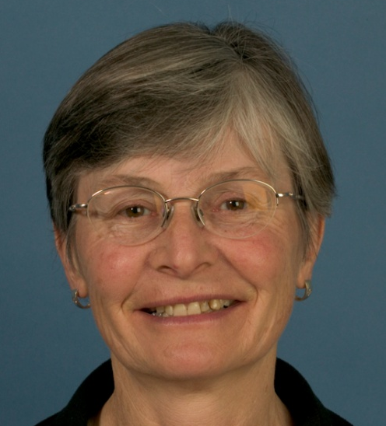
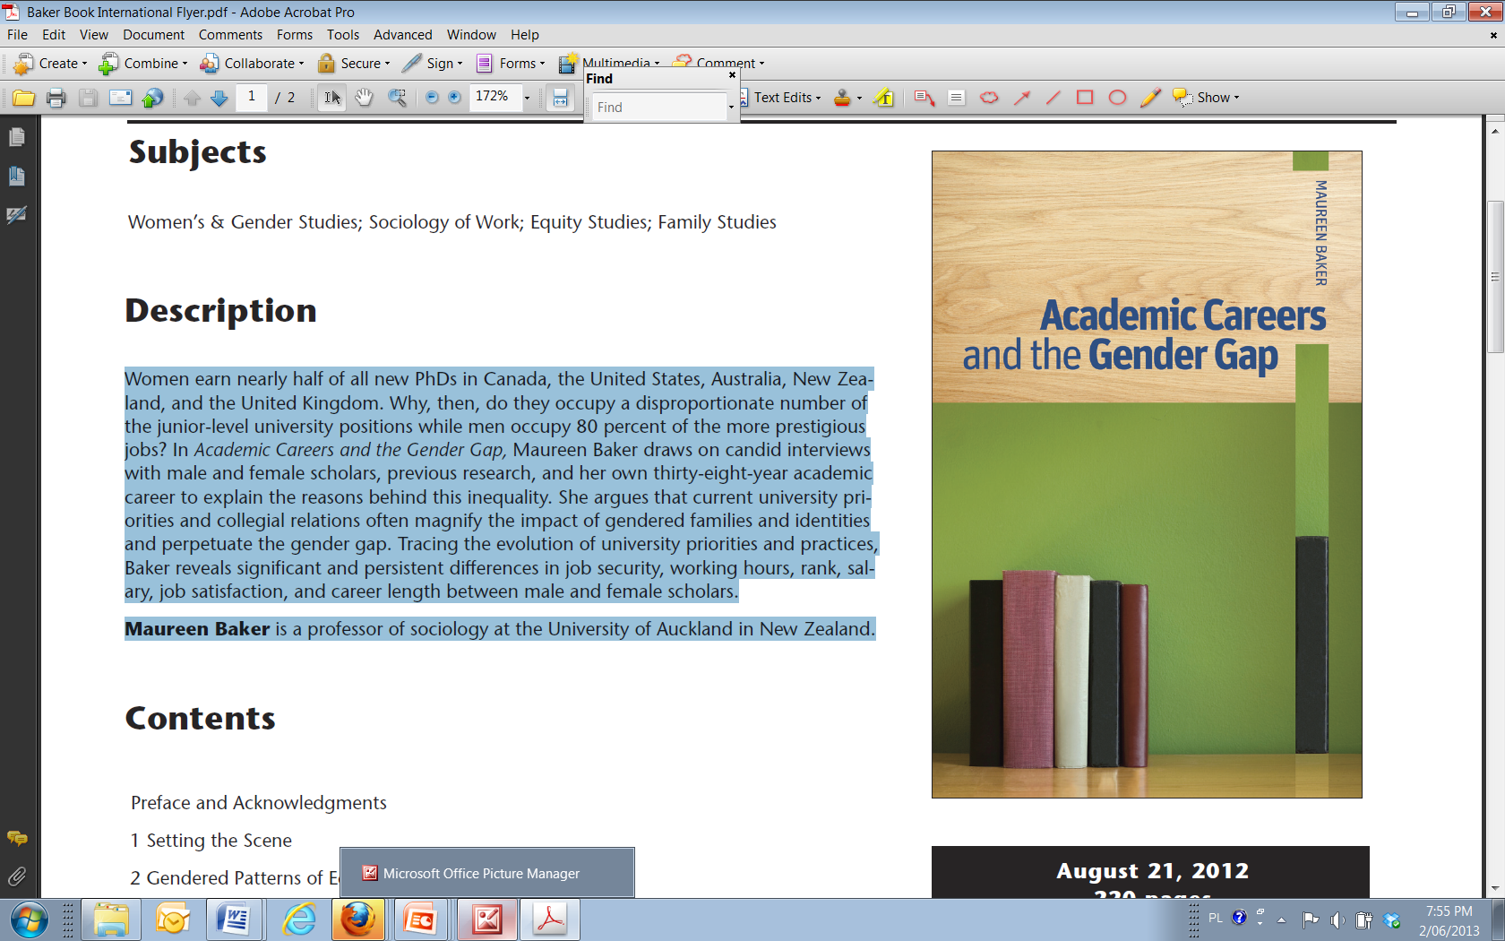
Monday, 2 September 2013
Women earn nearly half of all new PhDs in Canada, the United States, Australia, New Zealand, and the United Kingdom. Why, then, do they occupy a disproportionate number of the junior-level university positions while men occupy 80 percent of the more prestigious jobs? In Academic Careers and the Gender Gap, Maureen Baker draws on candid interviews with male and female scholars, previous research, and her own thirty-eight-year academic career to explain the reasons behind this inequality. She argues that current university priorities and collegial relations often magnify the impact of gendered families and identities and perpetuate the gender gap. Tracing the evolution of university priorities and practices, Baker reveals significant and persistent differences in job security, working hours, rank, salary, job satisfaction, and career length between male and female scholars.
Maureen Baker is a professor of sociology at the University of Auckland in New Zealand.

Slide 5
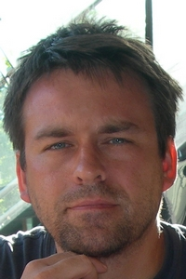
‘An in-depth analysis of organizational identification of female ECR academics at the ANU’.
Tuesday, 8 October 2013
Dr Dirk Van Rooy
I will discuss the results of on-going research project, in collaboration with the Diversity and Workforce Planning Branch, that examines the attitudes and aspirations of female Early Career Researchers (fECR’s) at the Australian National University (ANU). Using a combination of quantitative survey measures, social network and automated text analysis, the research provides an unique insight into the social, cognitive and emotional processes from which multiple, sometimes conflicting identities and attitudes emerge. The impact of the current findings on theories of identity and organizational change management are discussed.
Dr. Van Rooy’s research focuses on the analysis of social psychological processes through the means of advanced quantitative analysis and computer simulations

Slide 6
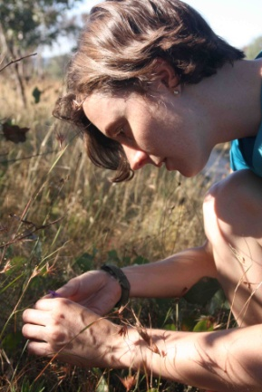
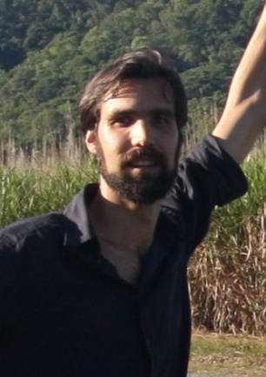
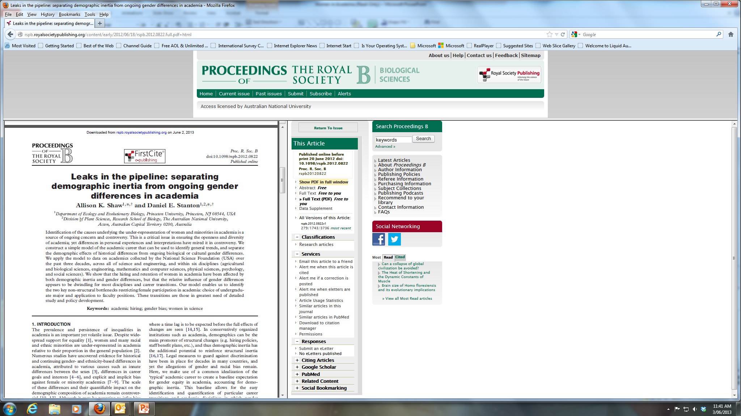
Leaks in the pipeline: separating demographic inertia from ongoing gender differences in academia
Monday, 5 November 2013
Dr. Daniel Stanton and Dr. Allison Shaw, Research School of Biology, Australian National University
Identifying the causes underlying the under-representation of women in academia is a source of ongoing concern and controversy, yet it is a critical issue in ensuring the openness and diversity of academia. Here we present a simple model of the academic career in which all gender differences in career transitions and retention are absent, which allows the effects of historical disparities to be separated from any ongoing gender differences. We apply the model to data on academics collected by the National Science Foundation (USA) over the past three decades.
Allison Shaw is a postdoctoral fellow at the ANU,
working with Hanna Kokko in Ecology, Evolution and Genetics.
Daniel Stanton is a postdoctoral fellow at the ANU,
working with Marilyn Ball in the Plant Sciences
Division of the Research School of Biology.

Slide 7

Women in Philosophy: What Needs to Change?
Edited by Katrina Hutchison and Fiona Jenkins
Forthcoming: Oxford University Press 2013
Women in Philosophy:
What Needs to Change?
Edited by: Katrina Hutchison and Fiona Jenkins

Slide 8
Beginnings…
Inspiration:
Addressing the Problem:
“There is a deep well of rage inside of me; rage about how I as an individual have been treated in philosophy; rage about how others I know have been treated; and rage about the conditions that I’m sure affect many women and minorities in philosophy, and have caused many others to leave” Sally Haslanger, 2008 “Changing the Ideology and Culture of Philosophy: Not by Reason (Alone)” Hypatia 23:2
  Improving the participation of Women in the Philosophy Profession: AAP report (2008)
  Symposium held at the ANU in August 2009
  International interest…
  Rage, depression, curiosity…What is it with philosophy???

Slide 9
Philosophy Teaching and Research staff in Australian universities 2003-2009 by gender (AAP benchmarking)

Slide 10
FTE for Fulltime and Fractional Fulltime Philosophy Teaching and Research staff in Australian universities by level and gender Data Source: AAP Benchmarking Collection (Philosophy)

Slide 11
Philosophy : to other disciplines (AU, 2009)
Data Sources: DEEWR Higher Education Statistics (all disciplines), AAP Benchmarking Collection (Philosophy)

Slide 12
Undergrad: Women take more Phil courses (54%); fewer complete majors (44%)
Undergrad EFT student load and Bach. degree completions by gender for Phil programs at AU universities (source: DEWRA and AAP) At PhD about 40% female completions

Slide 13
Women’s Under-representation
Why does it matter?
Political/ legal representation – or power
Individual capacity for advancement – or money
Use of talent - Fulfilling socio-economic objectives
In Philosophy?
Concern for justice and elimination of bias integral to discipline?
Knowledge is situated therefore we need to be inclusive?
Powerful (and deeply sexist) tradition – demands contestation from within?

Slide 14
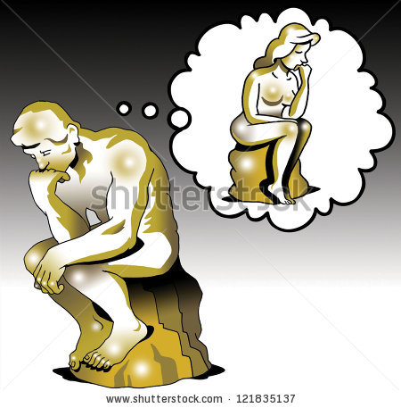
Who is the philosopher?
Maybe there’s a kind of anti-botox that could give you brow wrinkles temporarily, kind of like an appearance enhancing drug for academic job interviews! – Samantha Brennan

Slide 15
Entrenched beliefs
Hiring women in philosophy doesn’t matter to the outputs of the discipline.
(equity has nothing to do with ‘excellence’ – and maybe inequity helps…?)
Reasons for women’s absence are external to the discipline (ie. there is no specific problem for women in philosophy)
Philosophy produces gender-neutral knowledge (like science?)
Success is based in conforming to prior gendered models – great man syndrome
There is a trend toward increasing numbers of women – no need to do a thing!

Slide 16
Its getting better all the time…?
Maybe not…
Explanation?
July 2005-March 2013, New Zealand philosophy departments appointed 20 men but only one woman (to a 0.5 position).
Re-masculinization of discipline (Haslanger)
Adaptation of discipline to changing (neo-liberal) academic institutions (Jenkins)
Impact of PRBF (ERA equivalent)
Journal rankings favour research in male-dominated areas
Reproduce previous success
Strong gender segregation between different areas of philosophy
Over 80% of women in philosophy identify as doing feminist philosophy – only one journal of feminist philosophy has A* ranking

Slide 17
Implicit bias
Stereotype threat
Micro-inequities
Norm and deviance
Gender and organisation
Why not leave this to (proper) social scientists?
“There is a complete spectrum between the mini-incidents and the big unambiguous ones that most people would agree are sexist or racist. Clearly we need to eradicate the big unambiguous examples of discrimination, but are some (most?) people willing to accept micro-inequities because the incidents are, in many cases, so ambiguous? Where do you draw the line between deciding that someone is oversensitive vs. the target of habitual disrespect?” Blog: Musings of a Science Professor at a Large Research University

Slide 18
Why get philosophers to look at this?
Internal knowledge of disciplinary practise: eg. uses of ‘intuition’; adversarial culture; nature of teaching heuristics; non-explicit methodology
Inhabiting tradition critically: engaging the ‘man of reason’ paradigm; standpoint matters; reclaiming a voice
Influence and importance of feminist philosophers inside/outside the discipline: critical interrogation of what concepts mean; how ideologies grip us; how binary dualisms (eg reason/emotion) limit potentials…
Building professional solidarity: You are not alone!

Slide 19
University Graduates and academic career progression by sex: Australia, 1996 and 2006: Australian Federation of Graduate Women Report 2013

Slide 20
Lived Experience of this career?
Women
Men
More likely to enter a ‘deviant’ path of study
Questioner/ Silenced
Experience of time at odds with career path: potential; conflict; failure
Service
Merit-gap - ‘Post-discrimination blues’
Likely to experience self as norm
Authority
Normative career path: potential; achievement; acclaim – high valuation
Leadership
Merit-rewarded – What discrimination???

Slide 21
What needs to change?
Women? Or institutions? Women’s performance? Or standards by which performance is judged?
  Ways of deciding merit? Or faith in meritocratic processes?
Modes of judgment: External assessment processes that re-masculinise the discipline; Internal practices that perpetuate bias
  Recursive justifications for continuing ‘business as normal’: look at systemic results rather than case-by-case and use them to raise questions about practises
  Empower women to be true ‘peers’ and judges

